Slide 1
STEAM Resources for the Middle School Classroom
Tracy Iammartino, NBCT
5-8th Engineering Teacher
Bridge School
Notes:
Have multiple websites open so presentation runs smoothly.

Slide 2
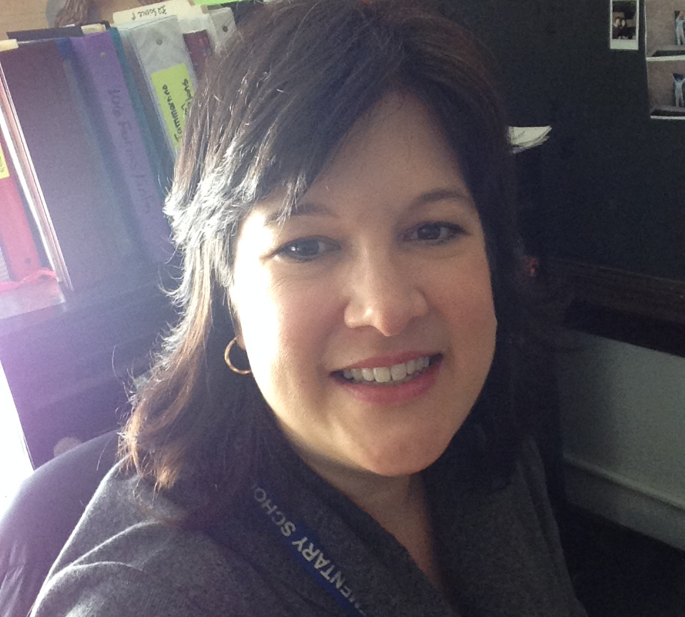
Hello!
I am Tracy Iammartino
I am here because I love to tinker, explore and share.
You can find me at tliammartino@cps.edu and @TIammartino or check out my school’s website
http://bridge.cps.edu/
or at my personal website
http://mstiammartino.weebly.com/

Slide 3
Objectives for this session:
Sharing of Resources to:
TEACH - resources that have lesson plans, templates, simulations to aid in planning STEAM units.
USE - resources that can be used to spark STEAM units.
PRESENT/ASSESS - resources to be used in assessment of students.
SAMR Model - A way to implement these resources so you don’t go crazy or give up.
Notes:
This is a sharing session. Throughout my 23 years of teaching I was always researching for innovative ideas and always hoping that someone would put some together for me! So I have tried to do this for you!

Slide 4
Resources to use in planning.
1
“Don't ask kids what they want to be when they grow up but what problems do they want to solve. This changes the conversation from who do I want to work for, to what do I need to learn to be able to do that.”
-Jamie Casap
Notes:
For any STEM/STEAM unit planning is the key. Knowing what you want to teach, what objectives you wish to meet, and what materials are needed is so important. If this is not done, one can get swamped in a million details and lose focus. Looking at the quote (my favorite by the way) helps focus my goals of guiding students to solve problems in their life/community/world.

Slide 5
Websites for planning:
Teach Engineering
https://www.teachengineering.org/
Engineering is Elementary
https://www.eie.org/
Hacking STEM Activity Lab
https://www.microsoft.com/en-us/education/education-workshop/activity-library.aspx
Google Applied Digital Skills
https://applieddigitalskills.withgoogle.com/c/en/curriculum.html
Tech Girlz - free kits and plans
https://www.techgirlz.org/
Streamable Learning - look in your Safari Montage account. Free online field trips!
Sign into your Safari Montage, click on “Streamable Learning”.
Notes:
Let teachers know they all have a free microsoft account. They can download Microsoft applications to at least 4 devices! Thank you CPS. If you have questions please see your school TechCo

Slide 6
Websites to use in lessons.
2
“We keep moving forward, opening new doors, and doing new things, because we're curious and curiosity keeps leading us down new paths.”
-Walt Disney
Notes:
These are web tools that I have found to be amazing! There are no set lesson plans but my hope is that you find these sites as wonderful as I do and find a way to use them. I will explain how I use them, maybe you have a better idea...

Slide 7
Websites for student use:
3D websites
https://www.tinkercad.com/
https://www.onshape.com/
Graphic Design software (free download)
https://inkscape.org/
Easy animation site - Powtoon
https://www.powtoon.com/home/
App design - can only test on android products
http://appinventor.mit.edu/explore/
Coding program -Scratch (if you haven’t used yet...you need to!)
https://scratch.mit.edu/
Soundation - this is just cool!
https://soundation.com/
Notes:
Helpful hint - make a classroom account and have students use the classroom account. Helps with password retention (put on Google Classroom so no forgetting password).
Some site allow “Sign in with Google so students can sign in easily”.

Slide 8
Resources to use in assessment.
3
“LEARNING IS NOT ATTAINED BY CHANCE, IT MUST BE SOUGHT FOR WITH ARDOR AND ATTENDED TO WITH DILIGENCE.”
―ABIGAIL ADAMS

Slide 9
Websites for assessment ideas:
Google Add on - Screencastify
https://www.screencastify.com/
Animoto - make your own videos
https://animoto.com/
Flipgrid - students make videos on a topic
https://flipgrid.com/
Polling students
https://www.gosoapbox.com/
https://www.polleverywhere.com/
https://get.plickers.com/
Kahoot! - my fav for classroom competition
https://kahoot.com/
Blabberize
https://blabberize.com/
Notes:
Helpful hint - make a classroom account and have students use the classroom account. Helps with password retention (put on Google Classroom so no forgetting password).
Some site allow “Sign in with Google so students can sign in easily”.

Slide 10
http://blabberize.com/view/id/1849941

Slide 11
How do I use all this in my classroom??? Don’t worry… the SAMR model can help.
4
“Change is always tough. Even for those who see themselves as agents of change, the process of starting a new thing can cause times of disorientation, uncertainty and insecurity.”
―Joyce Meyer

Slide 12
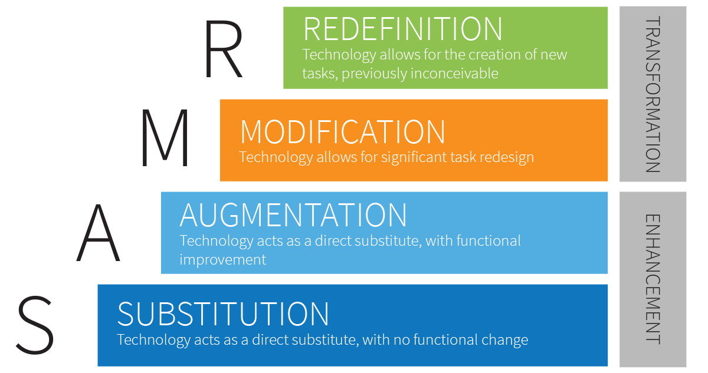
SAMR model:a framework created by Dr. Ruben Puentedura
Notes:
a framework created by Dr. Ruben Puentedura that categorizes four different degrees of classroom technology integration

Slide 13
SAMR model resources:
General information
https://www.schoology.com/blog/samr-model-practical-guide-edtech-integration
SAMR transformed lessons
https://www.iss.k12.nc.us/cms/lib/NC01000579/Centricity/Domain/4275/SAMR%20Transformed%20Lesson%20Examples-2.pdf
I challenge you to try one resource! I know you can do it and find success!!
Notes:
Helpful hint - make a classroom account and have students use the classroom account. Helps with password retention (put on Google Classroom so no forgetting password).
Some site allow “Sign in with Google so students can sign in easily”.

Slide 14
Thanks!
Any questions?
You can find me at:
@TIammartino
tliammartino@cps.edu
http://bridge.cps.edu/
http://mstiammartino.weebly.com/

Slide 15
Credits
Special thanks to all the people who made and released these awesome resources for free:
Presentation template by SlidesCarnival
Photographs by Unsplash

Slide 16
Presentation design
This presentation uses the following typographies and colors:
Titles: Nixie One
Body copy: Muli
You can download the fonts on this page:
https://www.fontsquirrel.com/fonts/nixie-one
https://www.fontsquirrel.com/fonts/muli
Aquamarina #00e1c6 / Turquoise #19bbd5 / Skyblue #2c9dde /
Light gray #c6daec / Dark blue #0e293c

